Slide 1
Object Code Form
Manik Sejwal
02111502716

Slide 2
Definition
In computing, object code or object module is the product of a compiler.
It is a sequence of statements or instructions in a computer language, usually a machine code language or an intermediate language such as register transfer language.
The term indicates that the code is the goal or result of the compiling process.

Slide 3
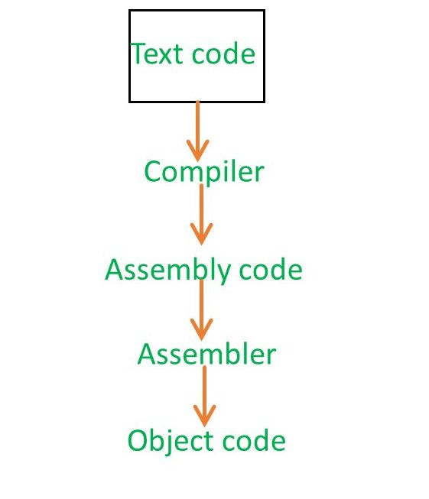

Slide 4
Object code is a portion of machine code that has not yet been linked into a complete program.
Object files can in turn be linked to form an executable file or library file.
In order to be used, object code must either be placed in an executable file, a library file, or an object file.

Slide 5
It is the machine code for one particular library or module that will make up the completed product.
It may also contain placeholders or offsets, not found in the machine code of a completed program.
Object code has the jumps partially parameterized so that a linker can fill them in.

Slide 6
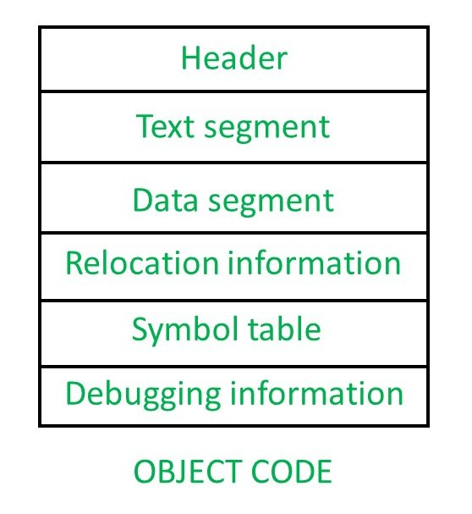

Slide 7
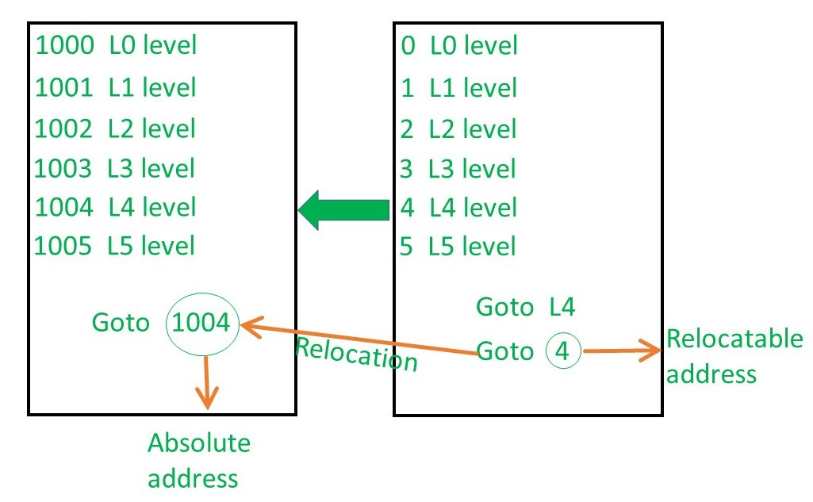

Slide 8
References
https://en.wikipedia.org/wiki/Object_code
https://www.geeksforgeeks.org/compiler-design-introduction-object-code/

Slide 9
Manik Sejwal
02111502716
CSE(M)

